Slide 1
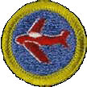
Boy Scouts Aviation Merit Badge
Control Surfaces
Notes:
The Boy Scout Aviation Merit Badge – Control Surfaces

Slide 2
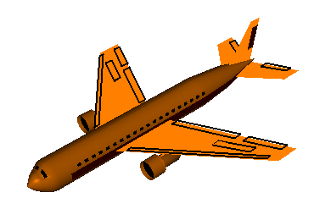
Primary Control Surfaces
Rudder
Ailerons
Elevator
Notes:
The Primary Control Surfaces of an aircraft are the ailerons, the elevator and the rudder.

Slide 3
Aileron
The ailerons are located near the rear end of the wing tip
Notes:
The ailerons are located near the rear end of the wing tip

Slide 4
Aileron
controls the roll of the plane
Longitudinal axis
Notes:
The Aileron controls the roll of the plane along the longitudinal axis

Slide 5
Elevators
The Elevators are located on the horizontal stabilizer of the tail
Notes:
The elevators are located on the horizontal stabilizer of the tail.

Slide 6
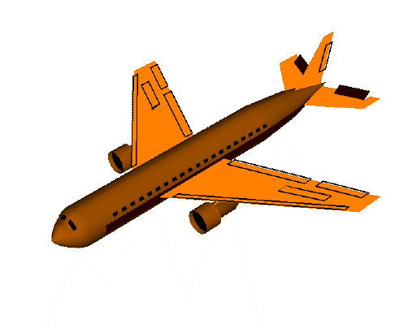
Elevators
controls the pitch of the plane
Lateral axis
Notes:
The elevators controls the pitch, or the up and down movement of the plane along the lateral axis.

Slide 7
Rudder
The rudder is located on the vertical stabilizer of the tail
Notes:
The rudder is located on the vertical stabilizer of the tail.

Slide 8
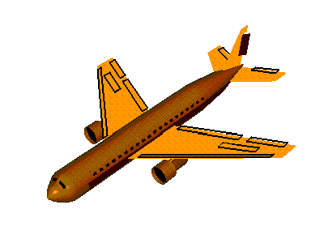
Rudder
controls the yaw of the plane
Vertical axis
Notes:
The rudder controls the yaw, or side to side, movement of the plane

Slide 9
Control Surfaces
Aileron – controls the roll of the plane
Elevator – controls the pitch, or the up and down, movement of the plane
Rudder – controls the yaw, or side to side, movement of the plane
Notes:
To recap the control surfaces, the aileron controls the roll of the plane. The elevator controls the pitch, or the up and down movement of the plane. The rudder controls the yaw or side to side movement of the plane.

Slide 10
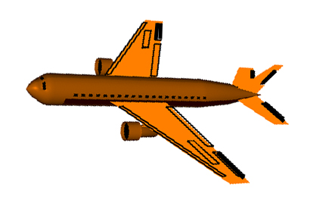
How the Control Surfaces Work Together for Flight
Take off down the runway
Aileron - level
Elevator – neutral
Rudder – neutral
Notes:
How the Control Surfaces work together for flight
When you are rolling down the runway, you want the plane to go straight. Your ailerons will be level. Ailerons are not used on the ground. The elevator is in the neutral position until you are ready to take off. Sometimes you may need to add left or right rudder, depending on the direction the wind is blowing. In this example, we will assume there is no wind. The rudder is also in the neutral position.

Slide 11
Control Surfaces
Straight Climb
Aileron - level
Elevator - up
Rudder – neutral
Notes:
In a straight climb, your ailerons are level. The elevator is in the up position. This drops the tail and causes the nose of the plane to go up. The rudder is in the neutral position.

Slide 12
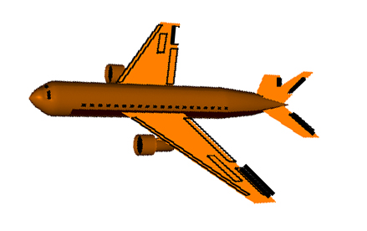
Control Surfaces
Level Left Turn
Aileron – left up, right down
Elevator – neutral
Rudder – left rudder
Notes:
In a left turn, the left aileron is in the up position and the right aileron is in the down position. This causes the plane to bank left. The elevator is in the neutral position because we don’t want the plane to climb. The rudder is in the left position to assist in the banking of the plane.

Slide 13
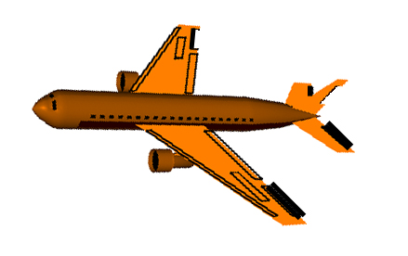
Control Surfaces
Climbing left turn
Aileron – left up, right down
Elevator – up
Rudder – left rudder
Notes:
In a climbing left turn, we want the plane to bank left as well as ascend. The left aileron is in the up position while the right aileron is in the down position to create the bank. The elevator is in the up position to create the lift. The rudder is in the left position to help with the left bank.

Slide 14
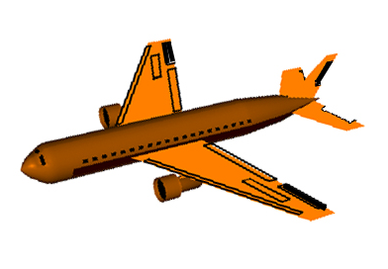
Control Surfaces
Straight descent
Aileron - level
Elevator - down
Rudder – neutral
Notes:
In a straight descent, we don’t want the plane to turn. The ailerons are level. The elevator is down and the rudder is neutral.

Slide 15
Control Surfaces
Landing
Aileron - level
Elevator - down
Rudder – neutral
Notes:
In the landing, we want the plane to land straight on the runway. The ailerons are level because we want the wings level to the ground. The elevator is down to assist in the descent. The rudder is neutral so that the nose and tail of the plane are straight down the runway.

Slide 16
Quick Quiz
What control surface controls the pitch, or the up and down movement of the plane?
Rudder
Aileron
Elevator
Notes:
Quick Quiz! What control surface controls the pitch, or the up and down movement of the Plane? The Rudder, the Aileron or the Elevator?

Slide 17
Answer:
What control surface controls the pitch, or the up and down movement of the plane?
Rudder
Aileron
Elevator
Notes:
The answer is the elevator! You have now learned about the control surfaces of an airplane.

