Slide 1
Guidelines for Recruiting and Retaining A Diverse Workforce – Embracing Diversity, Inclusion and Compliance
Jamie Ball – Director
Office of Equal Opportunity, Access and Title IX Coordination

Slide 2
What We Will Cover
Legal Standards in the Hiring Process
Recruitment Requirements
Advertising for an Excellent and Diverse Pool of Candidates
Tips and Guidelines For Building A Diverse Pool of Candidates
Ensuring a Fair and Thorough Review of Candidates
Starting the Interview Process
Reference Checks
Making the Offer
Record Retention
Key Things to Remember
Resources for Search Committees

Slide 3
Legal Standards in Hiring Process
Notes:
Title VII of the Civil Rights Act of 1964
Prohibits discrimination on the basis of race, color, religion, sex and national origin.
Americans with Disabilities Act Amendments Act (ADAAA)
Prohibits discrimination against qualified applicants with disabilities and requires reasonable accommodation of such individuals.
Age Discrimination in Employment Act (ADEA)
Prohibits discrimination on the basis of age (40 years or older)
Equal Pay Act
Prohibits employers from paying unequal wages to male and female employees who perform substantially similar jobs
Illinois Human Rights Act
In addition to the categories protected by the previously stated laws, IHRA also prohibits discrimination on the basis of sexual orientation, marital or civil union status, veteran status, and arrest records

Slide 4
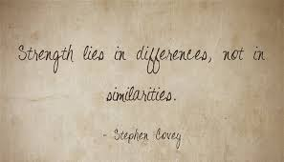
Recruitment Goals and Requirements
Notes:
When a job is underutilized or the department is underrepresented, positions are identified as “goal related.”
The Office of Equal Opportunity, Access and Title IX Coordination informs the hiring unit when positions are “goal-related.”
Search committees are required by the Office of Equal Opportunity, Access and Title IX Coordination to take extra measures to identify, recruit, and hire women and/ or racial/ ethnic minorities for these positions.
All University search committees should engage in inclusive recruitment activities that are consistent with University policy and effective for increasing the numbers of women and minority applicants for academic appointments.
An inclusive search ensures that positions are advertised with organizations and in publications targeted to women and minorities.

Slide 5
Advertising for an Excellent and Diverse Pool of Candidates
Notes:
Search efforts should include available avenues for publicizing the position, including national publications, personal contacts, list serves, mailing lists, professional and academic conferences and websites.
Search committees should develop a recruitment plan for advertising and outreach to produce desired results.
Departments are encouraged to use electronic job-posting services targeted at diverse groups such as minority organizations in specific disciplines.
The Office of Human Resources is taking active measures to post all approved positions in diverse outlets.

Slide 6
Tips and Guidelines For Building A Diverse Pool of Candidates
Notes:
Develop a broad position description, to attract a larger pool of qualified candidates.
Consider including “experience working with/teaching diverse groups/diverse students” as one of preferred criteria.
Make calls or send emails or letters.
Make an effort to identify contacts that have diverse backgrounds or experiences.
Call potential candidates directly to encourage them to apply.
Remember to actively involve your search committee members and delegate specific tasks to them.
Remember that your point is to expand the pool.

Slide 7
Ensuring a Fair and Thorough Review of Candidates
Notes:
Discuss the charge of the search committee.
Discuss in detail the position in question.
Discuss and develop criteria for evaluation.
Schedule meetings, timeframes and final deadlines.
Determine who will record and maintain all selection records and for what period of time.
Decide how conflicts of interest will be addressed.
Convictions listed on application does not automatically disqualify an applicant – depends on relevance of conviction to the position.
Create interview and rating forms to help keep track of and communicate with applicants.
Conduct the interviews in stages.

Slide 8
Starting the Interview Process
Notes:
BEFORE (screening)
Each application should be acknowledged
Candidates rejected after initial screening should receive notice – keep brief
If a candidate still under consideration has not completed all application requirements, notify them of additional documents needed
Select a “short list” of candidates to interview.
Circulate the candidates’ resumes
Articulate interview goals
Consider who will lead the interview
Determine interview structure and schedule
Develop set of core questions (feel free to ask probing questions outside of set core questions) but be consistent
Be sure interviewers are aware of what questions are appropriate

Slide 9
DURING (telephone)
Notes:
Follow the plan established
Remind interviewers of what questions are appropriate
The chair and other members introduce themselves
Explain the purpose, format, and agenda of interview to applicant
If interview is being recorded, make applicant aware
Briefly review the position
Give applicant a moment to become comfortable
Note taking by committee is encouraged
Listen and allow sufficient time to respond to inquiries
Conclude by thanking the applicant and explaining what will happen next
Documentation of all phone interviews should be maintained in records

Slide 10
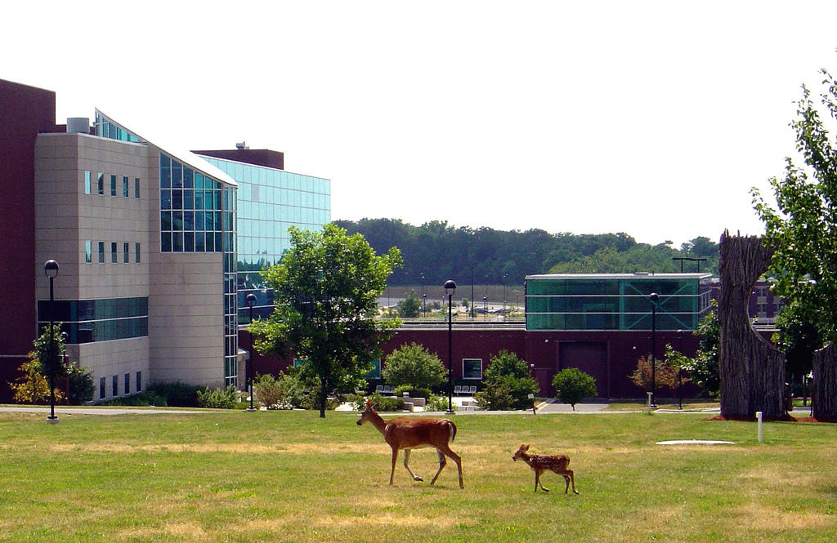
DURING (campus visit)
Notes:
Provide candidates with a detailed schedule
Provide opportunities for department to meet ALL candidates
Develop an information packet to share with all final candidates
Make candidates feel welcome
Focus on candidate’s ability to perform the essential functions of the job
Encourage all faculty and staff to attend candidates’ talk/lecture
All time for follow-up questions
Provide an opportunity for candidate to discuss any special requirements or circumstances
Remind interviewers to complete evaluations

Slide 11
AFTER
Notes:
Meet with the search committee as soon as possible
Follow process for making recommendations
Evaluate candidates for strengths and weaknesses
Raise awareness of unconscious assumptions
Selection criteria should be based on job description
Prepare and maintain documentation in a consistent manner
Select candidate(s) to recommend to Dean, Director, or Administrator

Slide 12
Reference Checks
Notes:
Use a standard reference and record checking procedure. Obtain consent as part of application process.
Application form also contains certification of accuracy as to credentials, criminal convictions, etc.
Don’t limit prior employment checks to listed references – speak with prior supervisors.
Best practice is to send a standard written request, including description of position sought.
Focus on position requirements and applicant’s qualification and suitability for the position.
Verify applicant’s information re: prior employment or other relationship with reference.
Verify credentials, licenses, etc.
Try to document EXACT words used by party during conversation. Do not speculate or assume that your description of comment is accurate.

Slide 13
WHAT NOT TO ASK:
Notes:
Arrest information/expunged criminal history;
Medical Conditions and Prior Occupational Accidents or Claims;
Discriminatory factors (age, race, religion, military, disabilities, marital/family status, child-rearing duties).

Slide 14
Making the Offer
Notes:
At the conclusion of the entire interview process, the search committee should meet to reach an agreement on a recommended list of finalists for the position.
The committee’s decision, with supporting documentation, should then be transmitted via memorandum to the appropriate administrator or hiring official.
The administrator or authorized hiring official should advise the search committee of the final decision.
Provide written justification for not recommending women or minority applicants when appropriate.
The dean, department chair or administrator will make the offer to the candidate.
The search committee chair should notify, in writing, all applicants who were interviewed that another candidate was selected prior to public announcements of appointment.
Be brief in detail, such as:
“After careful review and consideration, the University has now completed the search process for the position of _________. After careful consideration, the University has selected another candidate for the position. On behalf of the University, I thank you for your interest.”
Claims can arise when an applicant questions the decision of the Employer and believes it was wrong. Be convincing but courteous.
When notifying unsuccessful candidates, do not compare their qualifications with the person selected.
Claimants normally disagree with the University’s assessment of their qualifications.

Slide 15
Record Retention
Notes:
Under Federal EEO Record-Keeping Requirements, an employer must maintain all personnel and employment records, including application forms, for a minimum of three years.
If a lawsuit is filed, materials must be maintained until the case is resolved and appeal rights expire.
It is best practice to make clear to applicants that their materials do not remain “active” after consideration for the position sought and that they should reapply for future positions.
For individuals who are hired, there should be a consistent practice about which application materials will be retained or destroyed after the three-year period.

Slide 16
Key Things to Remember
Recognize and understand the serious implications of a search committee, a job description and the ultimate hire.
Be consistent and transparent in the search process.
If unsure of an issue during the process, stop the process and seek assistance from the appropriate office.
Dean’s Office, Provost, HR, EOA, Legal Counsel, etc…

Slide 17
Resources for Search Committees
Office of Equal Opportunity, Access and Title IX Coordination
650-2333
Office of Human Resources
650-2190
Office of the General Counsel
650-2514
Office of Office of Institutional Diversity and Inclusion
650-5382

